Slide 1
Analyzing NFL Spending by Position
Ace Padilla | Andrew Tamez
Matthew Thoms | Richard Viehdorfer
OA3802 – Fall 2024
Notes:
Ace

Slide 2
Agenda
American Football Overview
Web Scraping
Statistical Analysis
Simulation Model
Results
Web Dashboard
Conclusion
Notes:
Ace

Slide 3
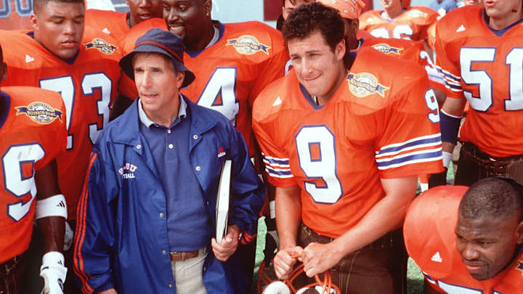
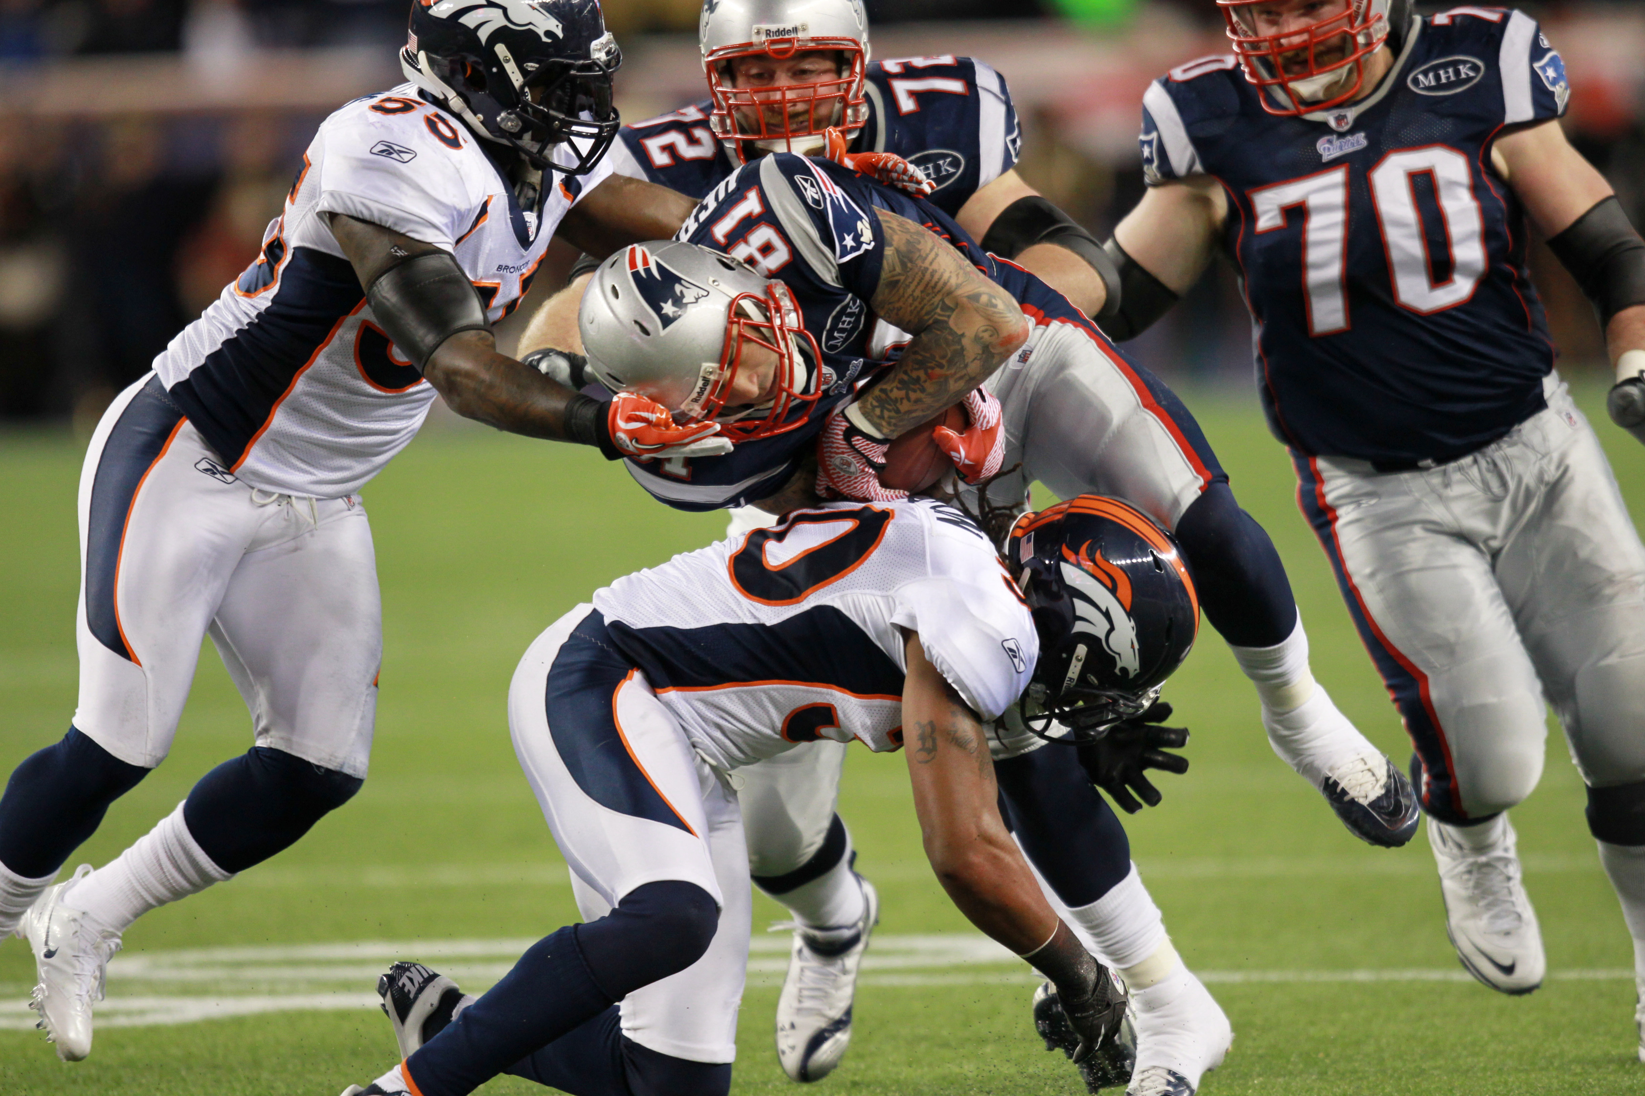
What is American Football?
2 Teams
11 Players on the field at each time
Attempt to advance the ball down the field by passing it or running it
If you don’t advance 10 yards in 4 plays, turn the ball over to the other team
6 points for a touchdown (PAT, 2 Point Conversion)
3 points for a field goal
2 points for a safety

Slide 4
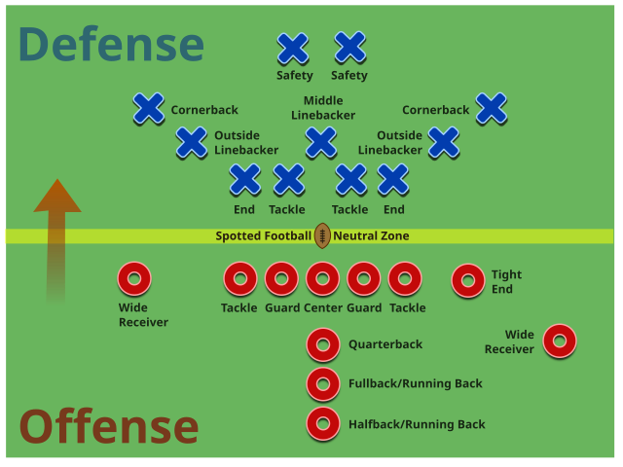
American Football Positions
Defense
Secondary
Linebackers
Defensive Line
Offense
Tight Ends
Offensive Line
Wide Receivers
Quarterback
Running Back

Slide 5
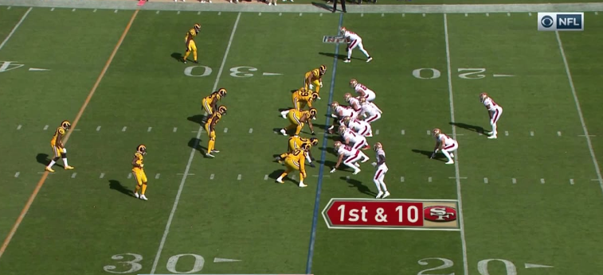
American Football Positions

Slide 6
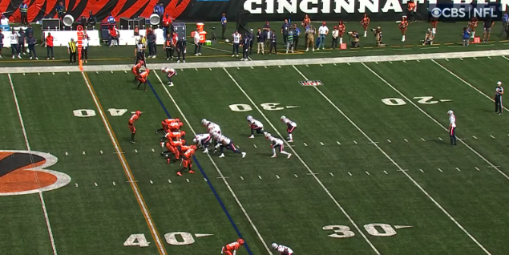
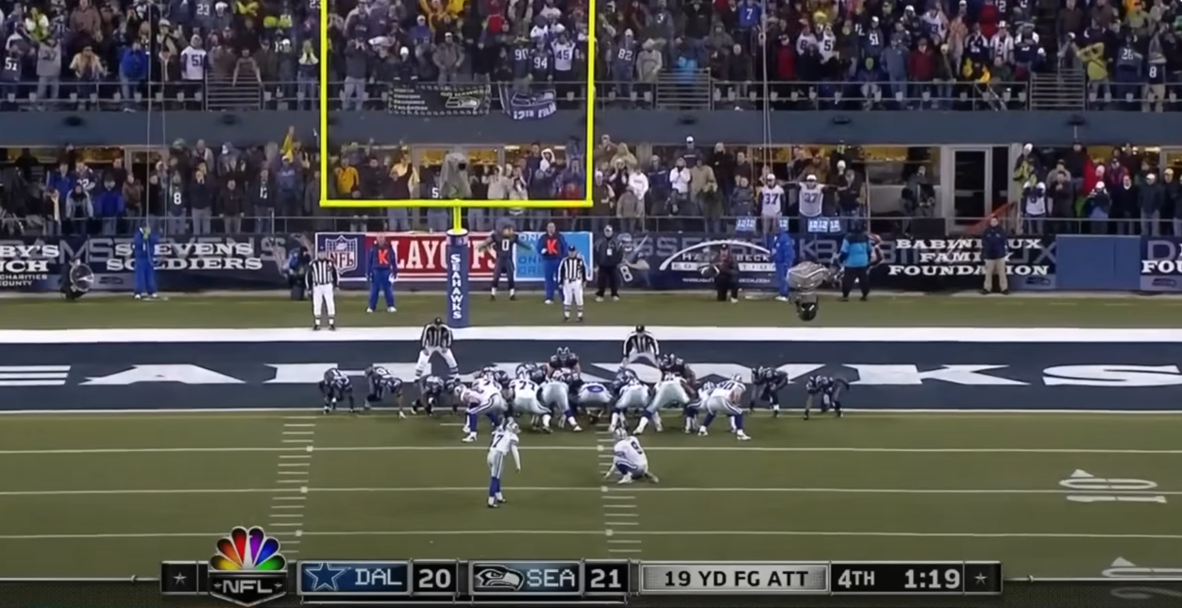
American Football Positions
Punter
Long Snapper
Kicker

Slide 7
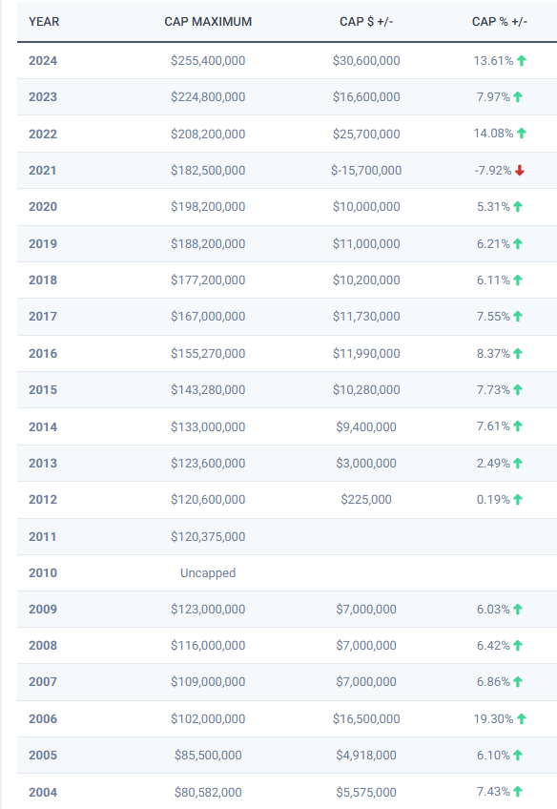
Salary Cap
Reflects the total amount a team can spend on its players per year
48% of total NFL revenue, divided by 32 teams
Increasing salary cap results in increased player salary
General Manager: role is to build and manage a team’s roster and oversee the football operations.
Player signings
Contract Negotiations
Working within the salary cap, how much do you pay which players to get the best chance of success?
Source: overthecap.com/salarycap
Notes:
Tom Brady Salary in 2007 (Undefeated Regular Season): Around $10,000,000 (Undefeated Regular Season, MVP, 50 TD Passes0

Slide 8
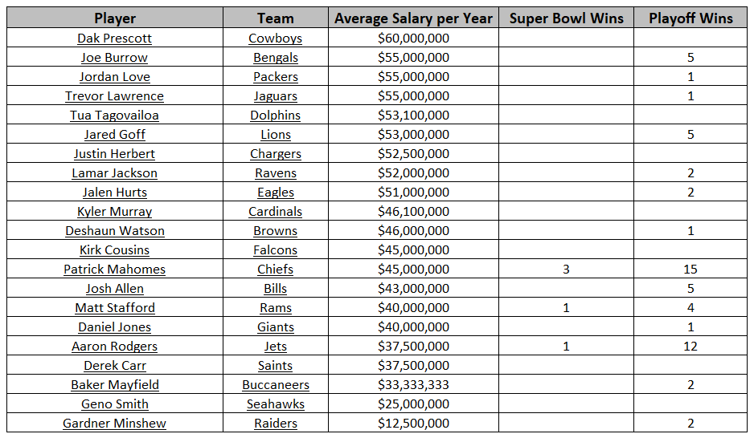
NFL Quarterback Salaries
Source: overthecap.com/position/quarterback

Slide 9

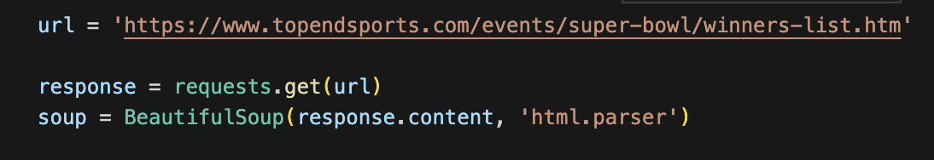
Web Scraping
Key tools: requests, bs4 python packages
Sources (no API with all the data needed):
Team Spending: https://www.spotrac.com/nfl/position/_/year/2024
Superbowl Winners (1966-Current): https://www.topendsports.com/events/super-bowl/winners-list.htm
Conference Champions: https://www.foxsports.com/stories/nfl/nfc-champions-complete-list-winners-year
Playoff Teams: https://en.wikipedia.org/wiki/NFL_playoff_results#All-time_playoff_records_(NFL/AFL)
Notes:
JASPR: The main purposes of this system are to reduce the time required to alert bystanders and to notify and orient first responders to the presence of an active shooter.

Slide 10
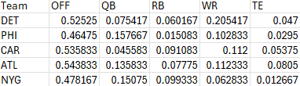
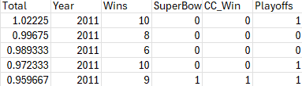
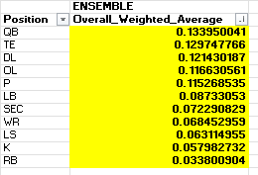
Statistical Analysis
Data
Independent Variables: Positions
Dependent Variables: Wins
Super Bowl, Conference Championships, Playoffs
Data Balance (0,1)
SB: 410 vs. 13
CC: 397 vs. 26
Playoffs: 268 vs. 155
R: Smote Package: SMOTE function - RDocumentation
“Artificially generate new examples of the minority class using the nearest neighbors of these cases.”
“Majority class examples are also under-sampled, leading to a more balanced dataset.”
Increases bias aligned with winning team particular features.
Emsemble Model per Independent Variable –
Balanced and Unbalanced – avg of (6) total
Ridge Regression
Logarithmic General Linear Model
Random Forest Classifier

Slide 11
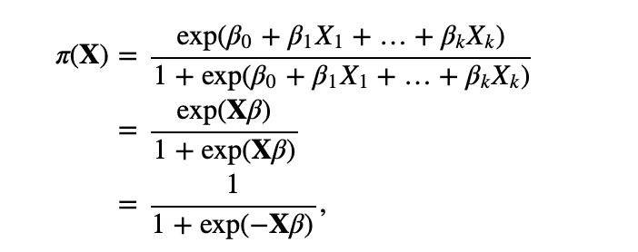
Simulation
Attempted HPC.
Randomize Spending Percentages
Utilize our calculated weights
Determine ​ the probability of win using binary logistic regression
Look at the top 10% of probabilities
What do we get?
Image courtesy of https://online.stat.psu.edu/stat462/node/207/
Notes:
JASPR: The main purposes of this system are to reduce the time required to alert bystanders and to notify and orient first responders to the presence of an active shooter.

Slide 12
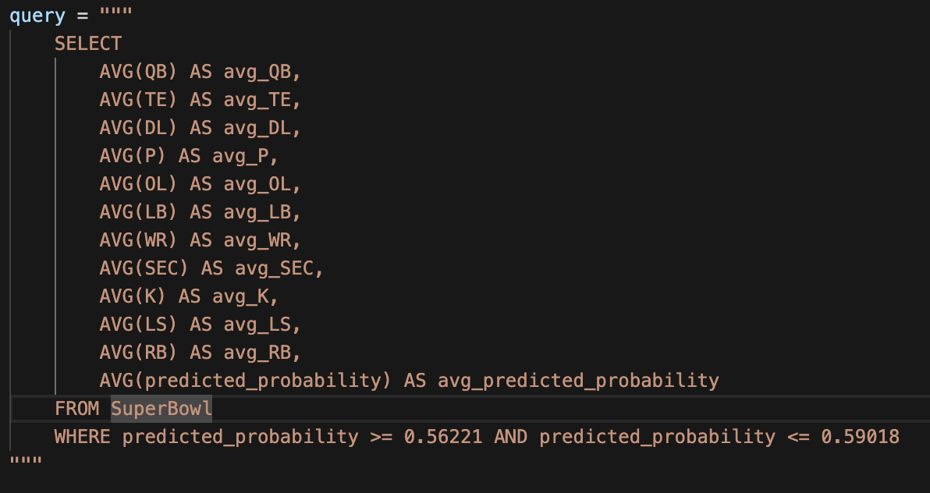
SQL Tables
Before we get to our results
Over 3 million data points. Best way to determine the values we want: pandas dataframe, excel, SQL?
With so many data points, let's go with SQL
Allows storage of more data within the database in a memory-efficient manner
Easy and efficient to query for the results we need
Looking for the mean/max is easy:

Slide 13
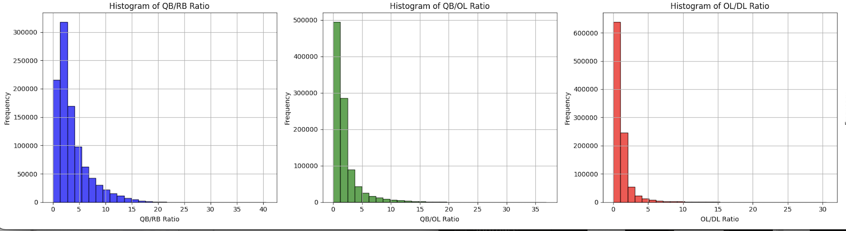
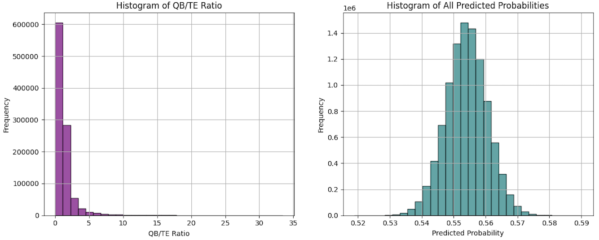

Results: SuperBowl

Slide 14
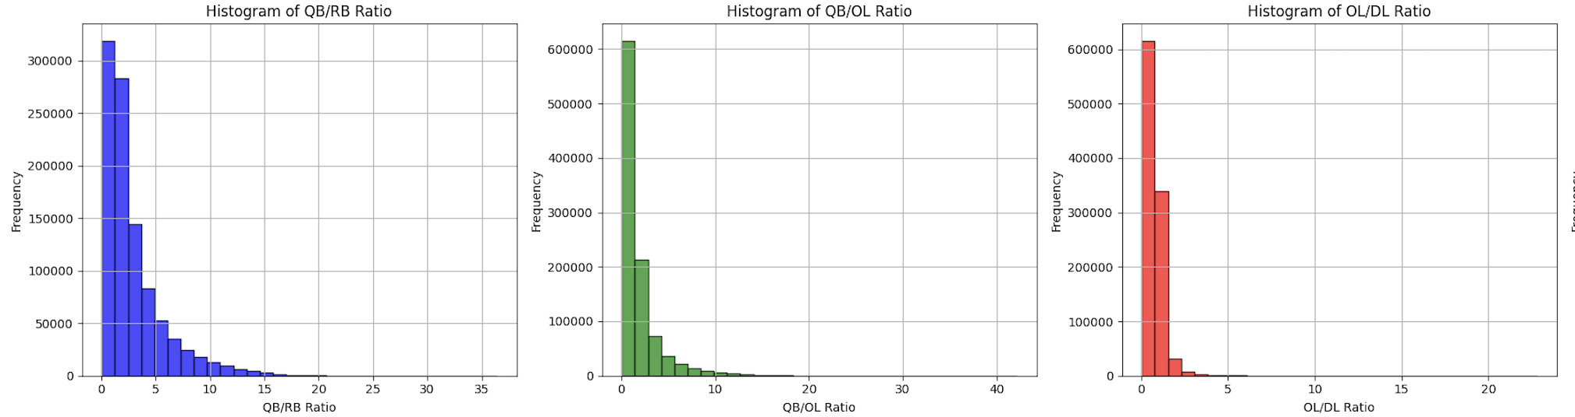
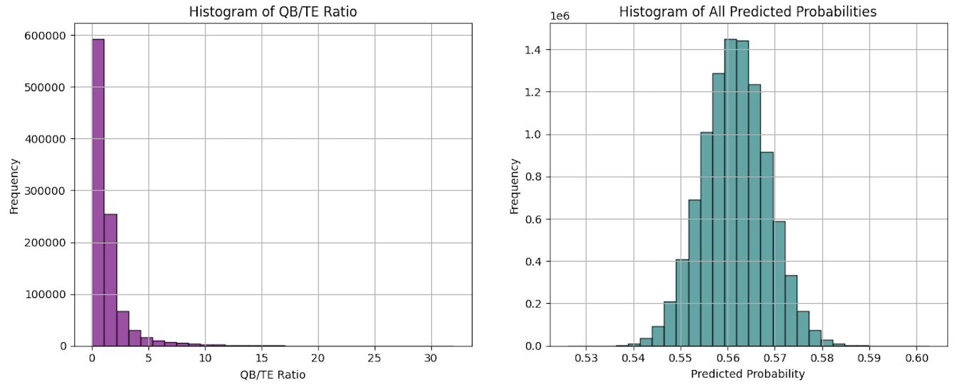
Results: Conference Champ. Wins

Slide 15
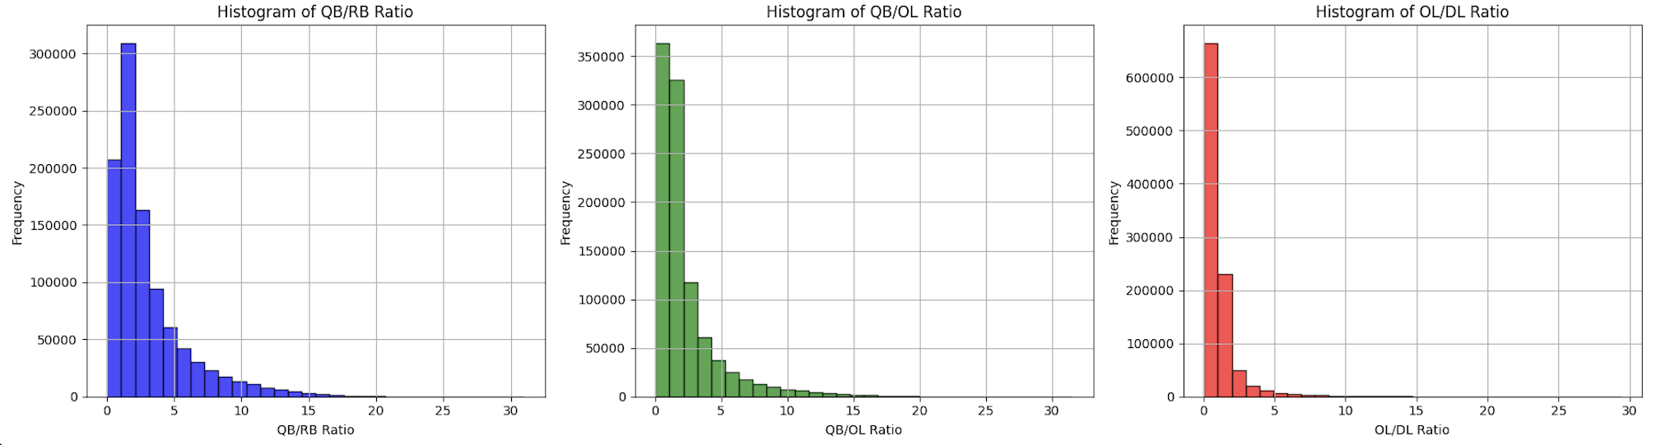
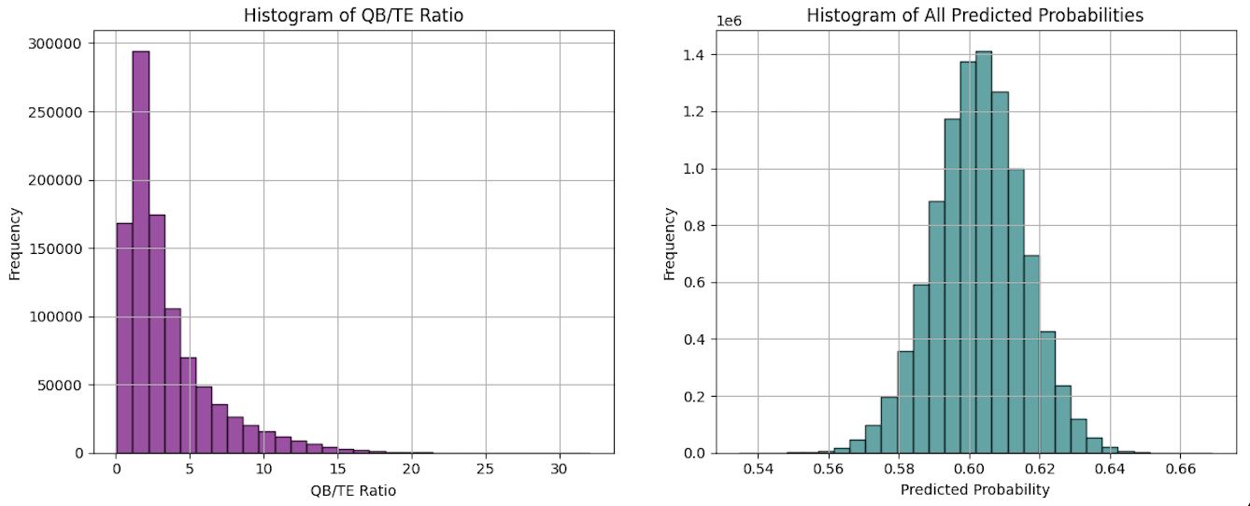
Results: Make the Playoffs

Slide 16
Dashboard

Slide 17
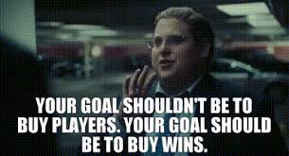
Conclusion
Recommendations: Pay QB twice as much as RB, OL = DL spending, QB = TE spending
Investing most of your money on a specific position doesn't result to wins; you need to balance the ratio between positions.
Future research:
Salary versus specific players stats that contribute toward wins
Analyze coach spending
Notes:
Injury and dak prescott
Refer to andrew' slides

Slide 18
Questions?

